Slide 1
SAMPLE DATASET

Slide 2
Example continues
Given a new object with the following features:
Colour: Red
Size: Small
Texture: Rough
weight: Light
Determine whether it is an apple. Show all the steps that made you to arrive to the final answer

Slide 3
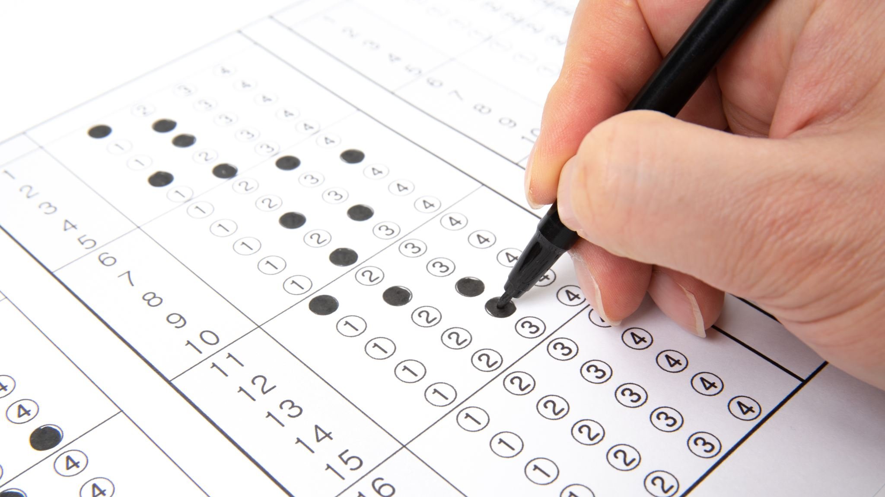
STEP 1: Calculate prior probabilities

Slide 4
Step 1
From the dataset determine P(Yes) and P(No)
We start with the target.
FORMULA:
P(Yes) = Number of 'Yes' / Total instances
P(No) = Number of 'No' / Total instances

Slide 5
Step 1
P(Apple=Yes) = Number of 'Yes' in Apple / Total instances = 5/10 = 0.5
P(Apple =No) = Number of 'No' in Apple / Total instances = 5/10 = 0.5

Slide 6

Step 2: Calculate likelihood probabilities

Slide 7
Step 2: Calculate likelihood probabilities
FEATURES
In our dataset:
P(Colour = Red)
P(Size = Small). P(Apple=Yes)
P (Texture =Smooth)
P(Weight = light)
P(Colour = Green)
P(Size = Larger). P(Apple=No)
P (Texture = Rough)
P(Weight = Heavy)

Slide 8
2.1 For yes probability of the target

Slide 9
Step 2.1: Calculate likelihood probabilities (yes) for yes target
P(Colour= Red∣Apple=Yes)= Number of colour=Red / Number of Apple=Yes = 5/5= 1
P(Size= Small∣Apple=Yes)= Number of Size=Small / Number of Apple=Yes = 3/5= 0,6
P(Texture= smooth∣Apple=Yes)= Number of Texture=Smooth / Number of Apple=Yes = 2/5= 0,4
P(Weight = light∣Apple=Yes)= Number of weight=light / Number of Apple=Yes = 2/5= 0,4

Slide 10
2.2 For no probability of the target

Slide 11
Step 2.2: Calculate likelihood probabilities (No) for yes target
P(Colour= Red∣Apple=No)= Number of colour=Green / Number of Apple=No = 0/5= 0
P(Size= Small∣Apple=No)= Number of Size=Large / Number of Apple=No = 2/5= 0,4
P(Texture= smooth∣Apple=No)= Number of Texture=Rough / Number of Apple=No = 3/5= 0,6
P(Weight = light∣Apple=No)= Number of weight=Heavy / Number of Apple=O = 3/5= 0,6

Slide 12
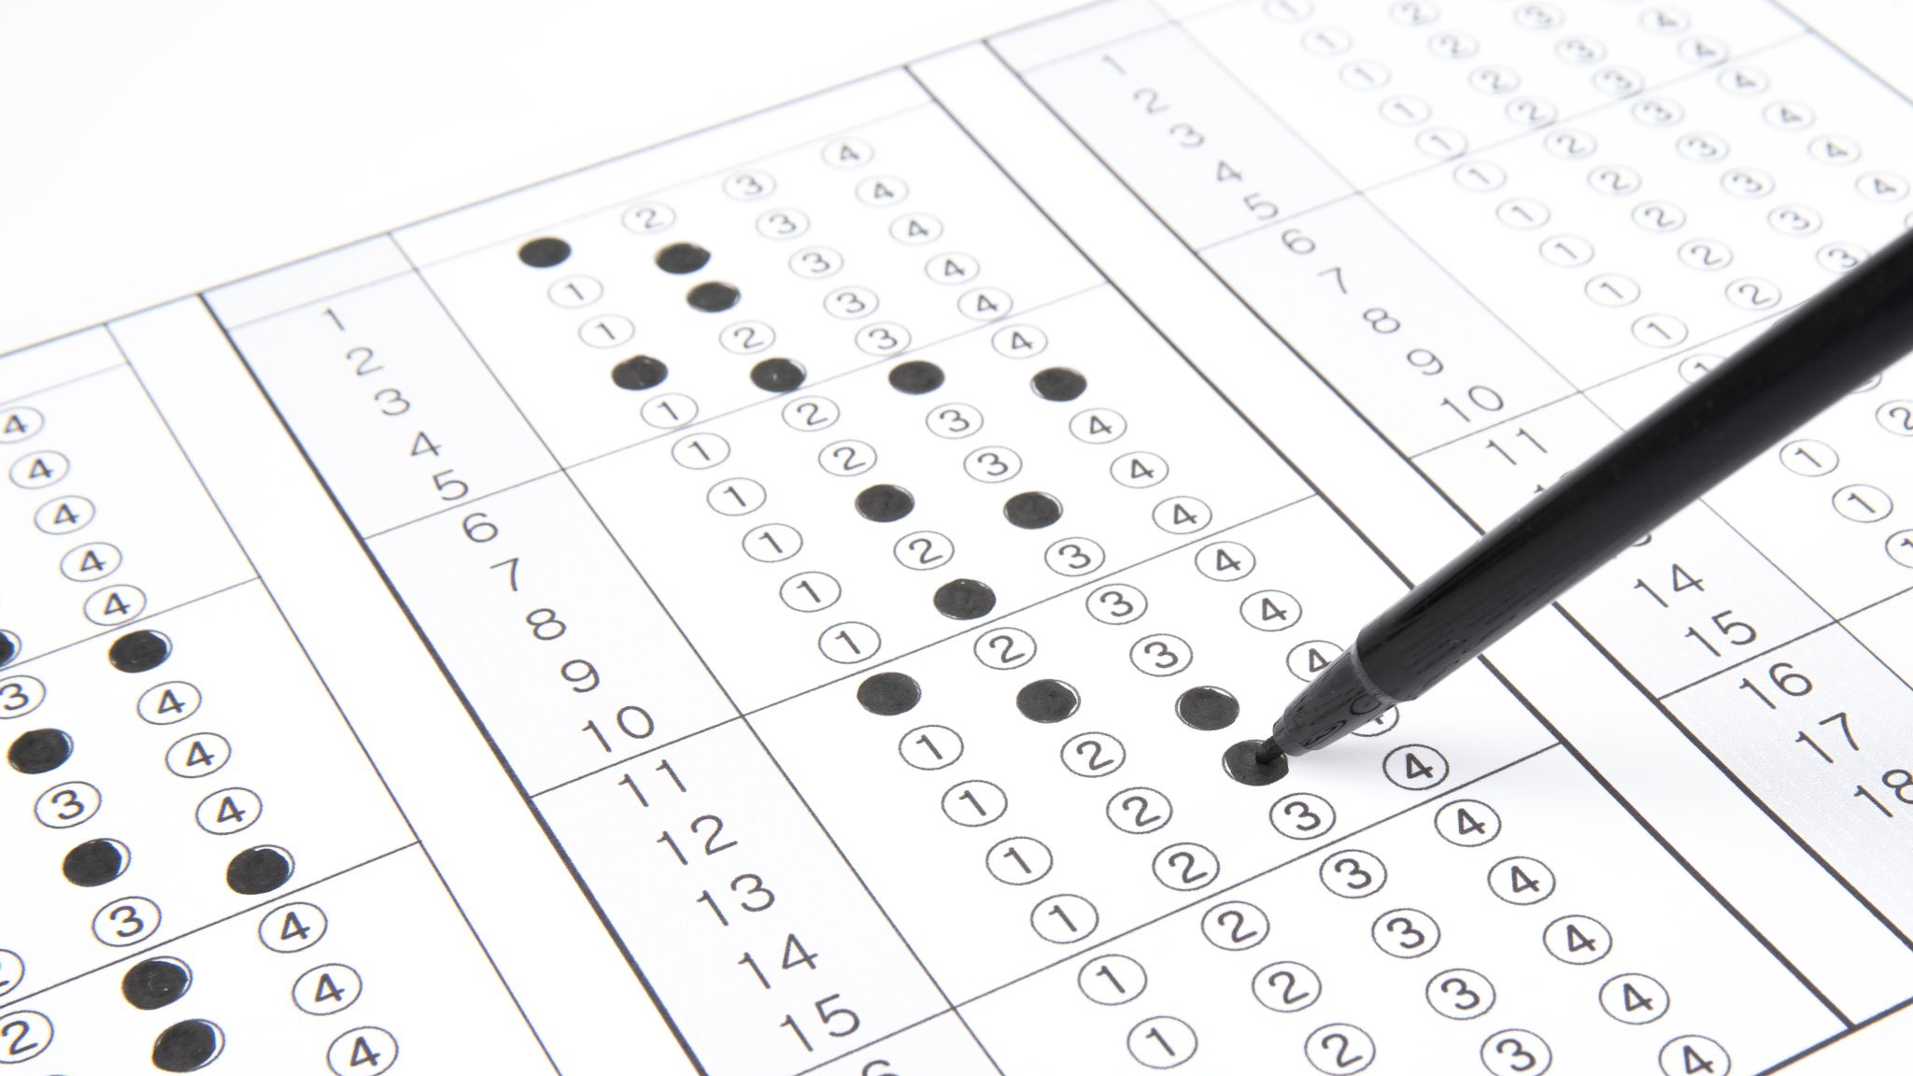
Step 3: Calculate Posterior Probabilities

Slide 13
3.1 For yes probability of the target

Slide 14
Multiply 2.1 together with p(yes) from step 1

Slide 15
=1x0,6x0,4x0,4x0,5 =0,048

Slide 16
3.2 For no probability of the target

Slide 17
=0x0,4x0,6x0,6x0,5 =0

Slide 18
Multiply 2.2 together with p(no) from step 1

Slide 19
Step 4: normalize posterior probabilities

Slide 20
Step 4 formula
4.1: P(colour= red∣size=small, texture=smooth, weight= light) = 0.048/0.048+ 0 = 1
4.2: P(colour= green∣size=large, texture= rough, weight= heavy) = 0/0.048+ 0 = 0

Slide 21
Step 5: provide the probability answer The new object is an apple

